Slide 1
Smart Construction Simulation
2026.7.7(Schedule) About the Release Version

Slide 2
Release Item List
We are pleased to announce the release of updates to "Smart Construction Simulation" with the following schedule and content.
Due to system maintenance, the relevant services will not be available during the following dates.
(*The release schedule, time, and contents are subject to change depending on the situation. Please understand this in advance.)
Schedule： Tuesday, July 7 (Japan time) 7:00 p.m. - 12:00 p.m.
NO. | Target Functions | Overview | Details
1 | Simulation (Function Improvement) | Maintaining IFC Display Status When Editing the Schedule | When editing tasks in the schedule, IFCs corresponding to the current schedule status are now displayed. You can now edit while keeping the schedule in its current state.
2 | Simulation (Bug Repair) | Fixed an issue where clicking the “Dashboard” link did not navigate to the relevant site after loading from the site list | We have fixed an issue where clicking the “Dashboard” link immediately after opening a site from the site list would redirect the user to the site list on the Dashboard.Now, even immediately after opening a site, the user will be redirected to the corresponding site on the Dashboard.
3 | Simulation (Bug Repair) | Fixed an issue where the route was not updated due to changes in soil volume when creating a soil distribution plan | We have fixed an issue where the route was not updated based on the soil volume set when creating a soil distribution plan. Just as during animation playback, the route will now update in response to terrain changes when creating a soil distribution plan.

Slide 3
Release Item List
NO. | Target Functions | Overview | Details
4 | Simulation (Bug Repair) | Fixed an issue where coordinate values were converted to meters and output on-site | We have fixed an issue where, when exporting terrain data (LandXML) from sites that use feet (ft) as their unit system, the coordinate values were being converted to meters (m). LandXML will now be exported using the site's unit system.
5 | Simulation (Bug Repair) | Fixed an issue where only dumps were displayed on non-working days on the schedule screen | We have fixed an issue where only dump trucks were displayed in the animation for non-operational days on the schedule screen. As with other construction machinery, dump trucks configured for soil distribution will now be displayed only on operational days.
6 | Simulation (Bug Repair) | Fixed an issue where changes to the change rate (C) were not reflected in the total soil volume display | We have fixed an issue where changes to the change rate (C) on the Cut/Fill Volume screen were not reflected in the total volume display. Changes to the change rate will now be reflected in the displays for each area and the total volume.
7 | Machine Simulation (Bug Repair) | Fixed an issue where trucks would be overtaken while waiting at a traffic light on a shared route | We have fixed an issue where a dump truck waiting at a traffic light on a shared lane would be overtaken by a dump truck in another lane. Overtaking will no longer occur while waiting at a traffic light.
8 | Machine Simulation (Bug Repair) | Fixed an issue where only dumps were displayed on non-working days on the schedule screen | We have fixed an issue where, in certain locale settings, the digit separator (.) automatically inserted when entering numbers with four or more digits was interpreted as a decimal point, preventing users from entering the correct values.

Slide 4
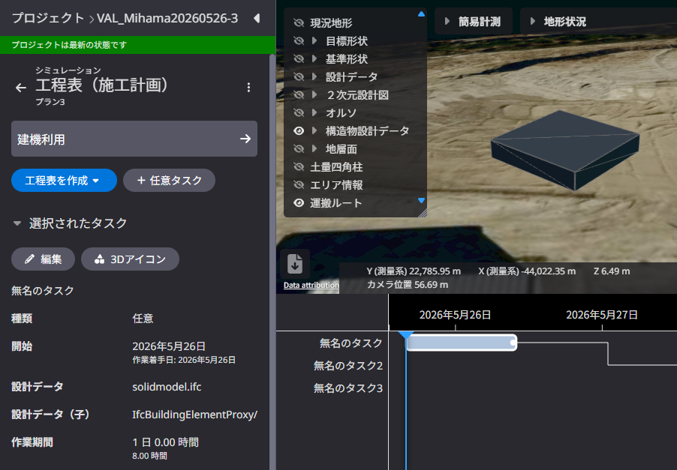
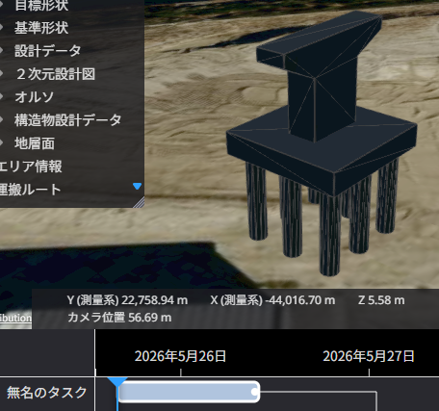

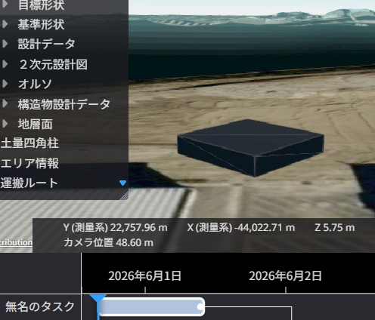
Release Item List
NO. | Target Functions | Overview
1 | Simulation (Function Improvement) | Overview：Maintaining IFC Display Status When Editing the Schedule Details：When editing tasks in the schedule, IFCs corresponding to the current schedule status are now displayed. You can now edit while keeping the schedule in its current state.
Before
After
Maintain the IFC display state even when editing tasks
タスク編集時もIFCの表示状態を維持

Slide 5
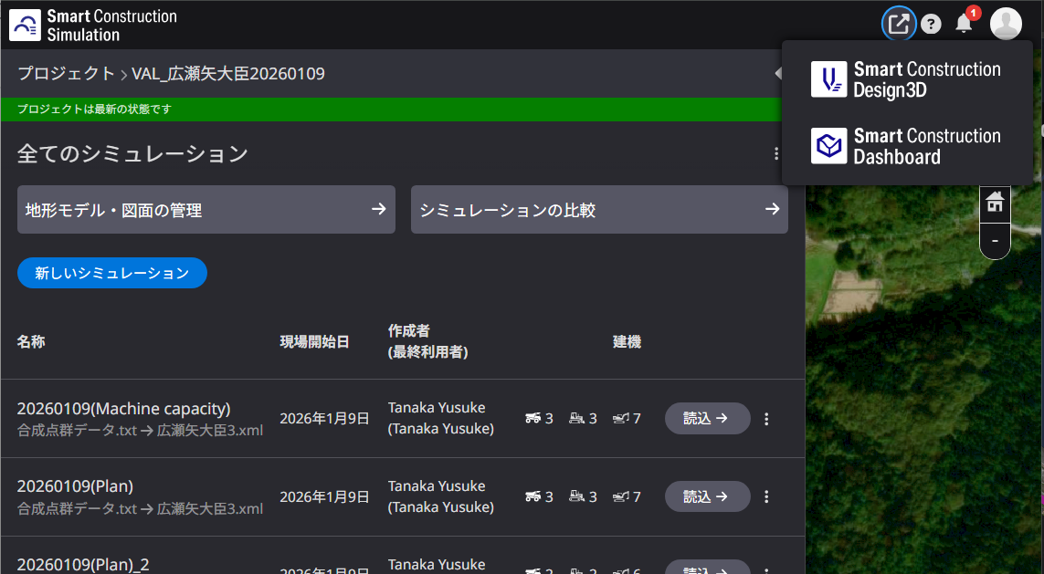
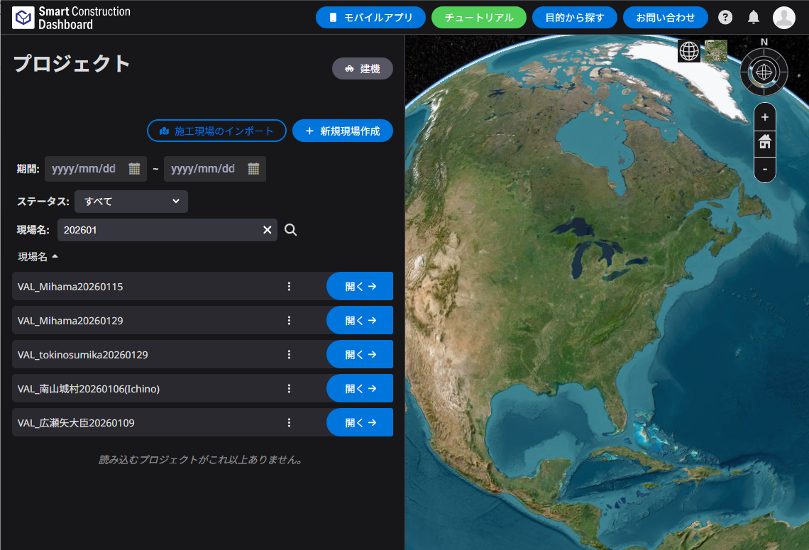
Release Item List
NO. | Target Functions | Overview
2 | Simulation (Bug Repair) | Overview：Fixed an issue where clicking the “Dashboard” link did not navigate to the relevant site after loading from the site list Details：We have fixed an issue where clicking the “Dashboard” link immediately after opening a site from the site list would redirect the user to the site list on the Dashboard.Now, even immediately after opening a site, the user will be redirected to the corresponding site on the Dashboard.
Clicking the “Dashboard” link takes me to the site list
Dashboardリンクで現場一覧に遷移していしまう
→ Modified so that it now takes me to the relevant site
該当現場に遷移するように改修

Slide 6
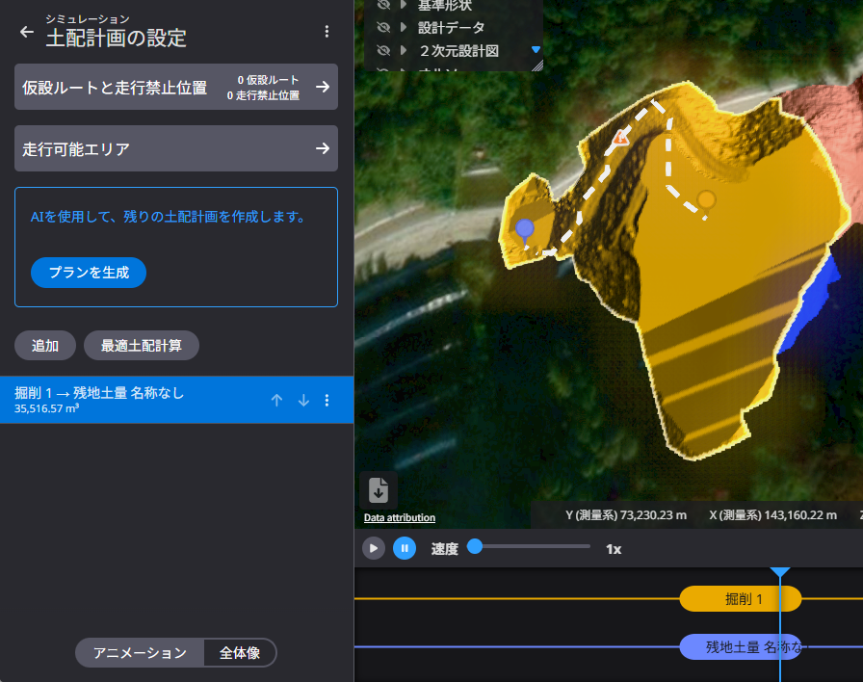
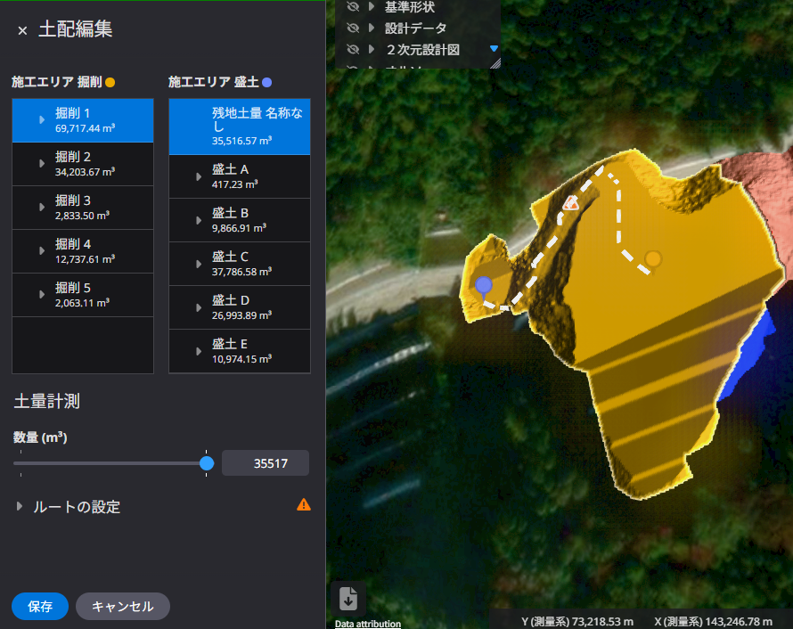
Release Item List
NO. | Target Functions | Overview
3 | Simulation (Bug Repair) | Overview：Fixed an issue where the route was not updated due to changes in soil volume when creating a soil distribution plan Details：We have fixed an issue where the route was not updated based on the soil volume set when creating a soil distribution plan. Just as during animation playback, the route will now update in response to terrain changes when creating a soil distribution plan.
Modified the system so that routes are updated based on terrain changes resulting from the soil volume set in the editing screen.
編集画面でも設定する土量による地形変化に応じてルートが更新されるように改修

Slide 7
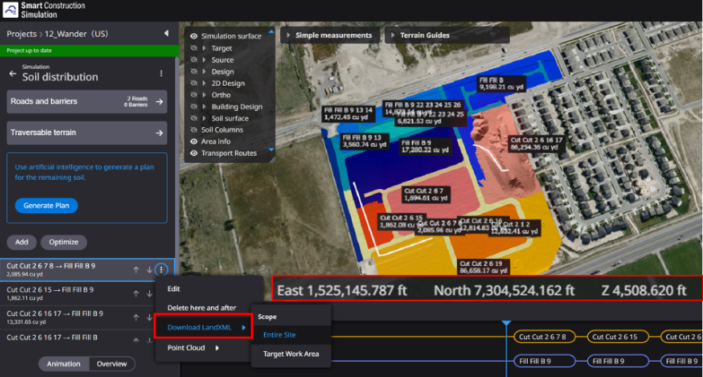
Release Item List
NO. | Target Functions | Overview
4 | Simulation (Bug Repair) | Overview：Fixed an issue where coordinate values were converted to meters and output on-site Details：We have fixed an issue where, when exporting terrain data (LandXML) from sites that use feet (ft) as their unit system, the coordinate values were being converted to meters (m). LandXML will now be exported using the site's unit system.
Modified the system so that LandXML is output according to the units used on-site
現場の単位に合わせてLandXMLが出力されるように改修

Slide 8
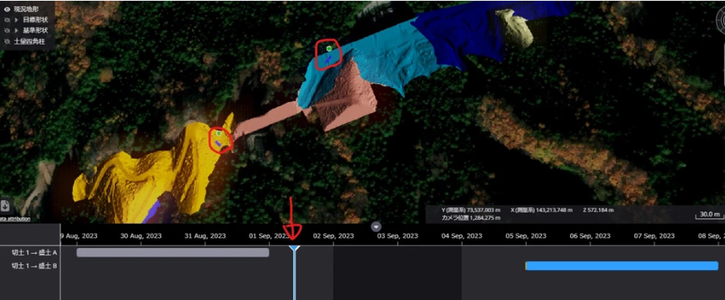
Release Item List
NO. | Target Functions | Overview
5 | Simulation (Bug Repair) | Overview：Fixed an issue where only dumps were displayed on non-working days on the schedule screen Details：We have fixed an issue where only dump trucks were displayed in the animation for non-operational days on the schedule screen. As with other construction machinery, dump trucks configured for soil distribution will now be displayed only on operational days.
Modified the system so that the dump is not displayed on non-business days
非稼働日にダンプが表示されないように改修

Slide 9
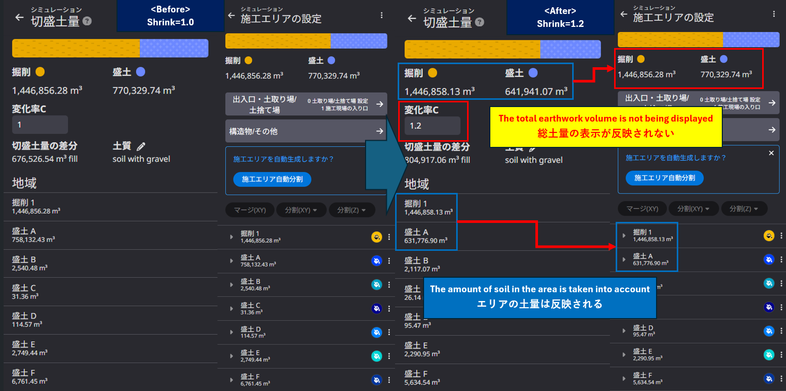
Release Item List
NO. | Target Functions | Overview
6 | Simulation (Bug Repair) | Overview：Fixed an issue where changes to the change rate (C) were not reflected in the total soil volume display Details：We have fixed an issue where changes to the change rate (C) on the Cut/Fill Volume screen were not reflected in the total volume display. Changes to the change rate will now be reflected in the displays for each area and the total volume.
Modified to reflect the total earthwork volume
総土量の表示が反映されるように改修

Slide 10
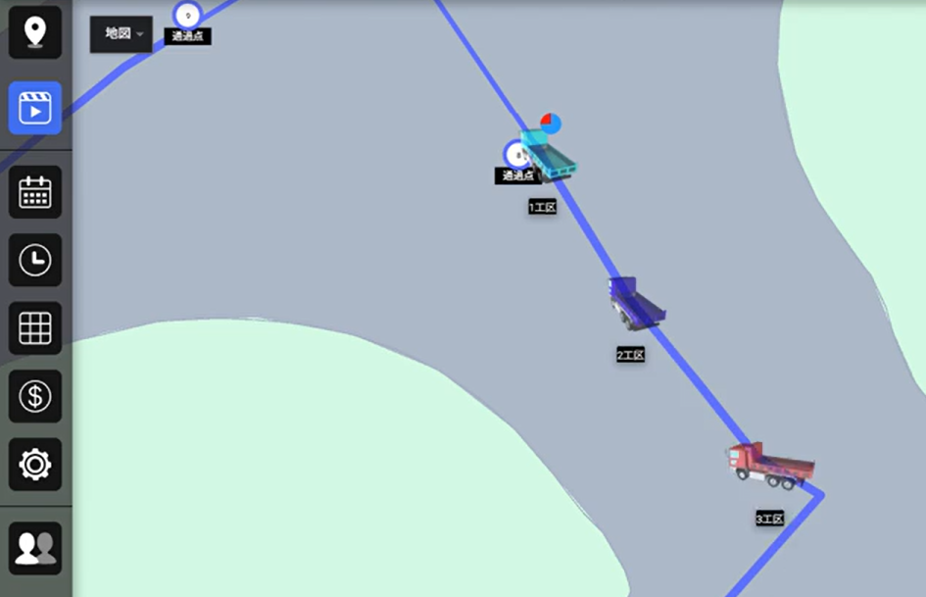
Release Item List
NO. | Target Functions | Overview
7 | Machine Simulation (Bug Repair) | Overview：Fixed an issue where trucks would be overtaken while waiting at a traffic light on a shared route Details：We have fixed an issue where a dump truck waiting at a traffic light on a shared lane would be overtaken by a dump truck in another lane. Overtaking will no longer occur while waiting at a traffic light.
Modified to prevent dump trucks in other lanes from passing while waiting at a traffic light
信号待ちで他走路のダンプに追い越されないように改修

Slide 11
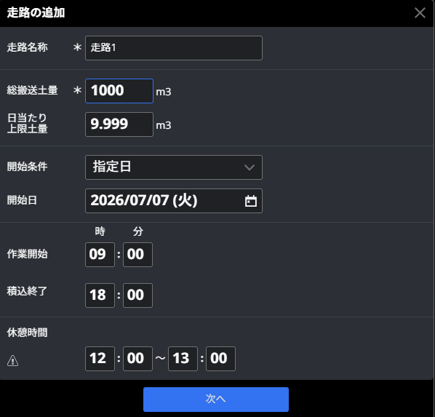
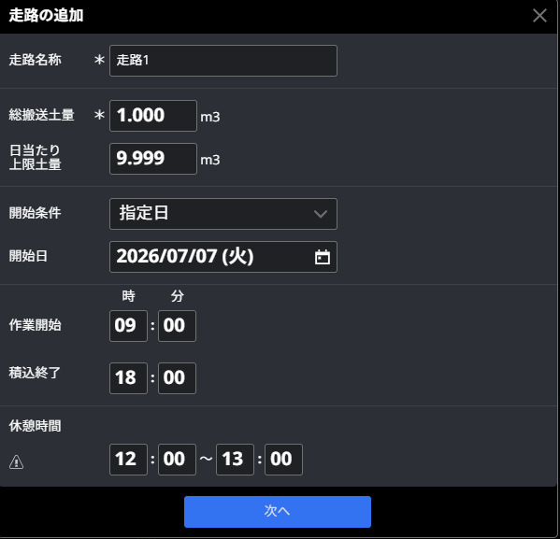

Release Item List
NO. | Target Functions | Overview
8 | Machine Simulation (Bug Repair) | Overview：Fixed an issue where only dumps were displayed on non-working days on the schedule screen Details：We have fixed an issue where, in certain locale settings, the digit separator (.) automatically inserted when entering numbers with four or more digits was interpreted as a decimal point, preventing users from entering the correct values.
Before
After
When a period is used as the digit separator, the number is deleted.
数値の桁区切りがピリオドの場合に、数値が削除されてしまう
Modified to allow entry of the intended values.
意図した数値が入力できるように改修

Slide 12
EOF

